Slide 1
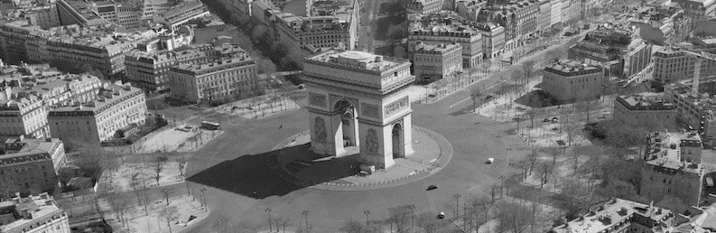
Use of geoprocessing to highlight the improvement of air quality in relation to confinement due to covid-19 in Paris area
Nicolas Beraud and Alex Paysant--Tholi
Notes:
Alex

Slide 2
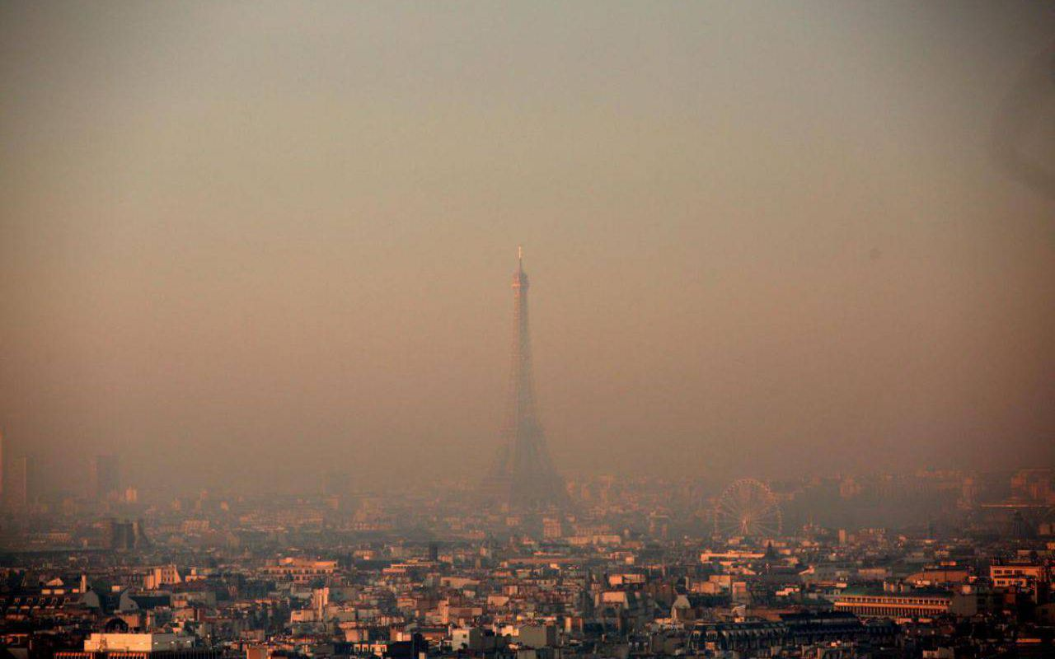
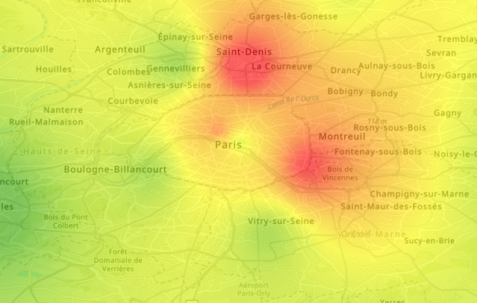
Objectives of the study
Determine if confinement reduced pollution (NO2) levels in Paris area using Airparif measurements
Visualize pollution levels on Paris map with ArcGIS
Estimate the number of people with better air quality
Provide a tool for users to make their own calculations
Notes:
Alex

Slide 3

Databases used for our project
Airparif is a French organization approved by the Ministry of the Environment for air quality monitoring in the Ile-de-France region.
Provides shapefile with quantities of pollutants in the air measured at the measuring stations (observed concentrations)
Data from 2017 to 2020 in our case
Notes:
Alex

Slide 4
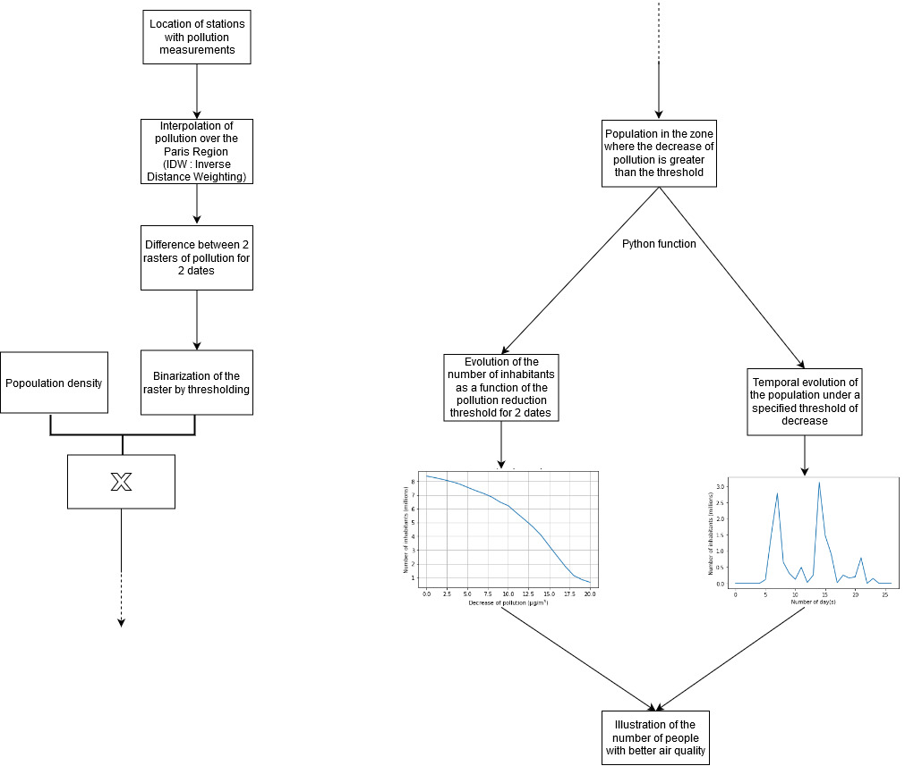
Flowchart
Notes:
Nicolas

Slide 5


Results
ArcGIS results with visualization
Programming results
Notes:
Nicolas

Slide 6
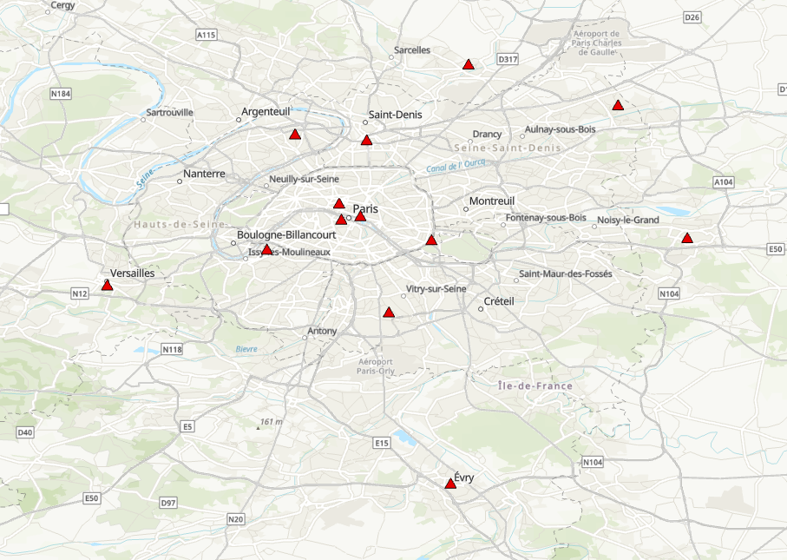
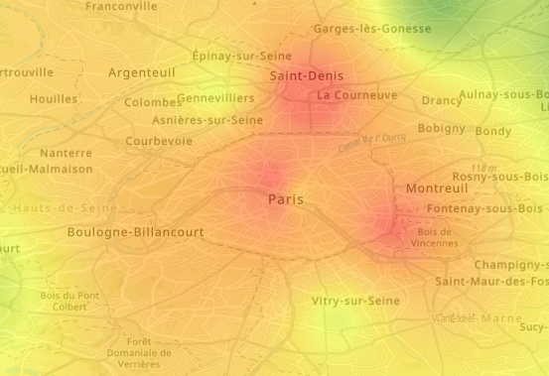
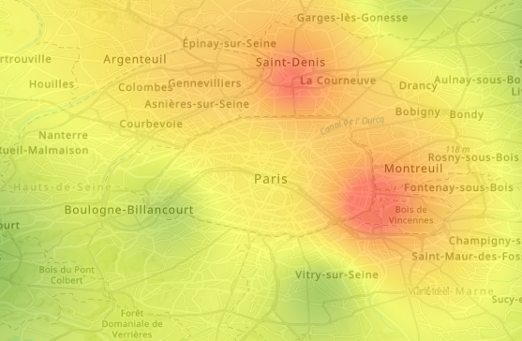
ArcGIS results with visualization
Localisation of 13 stations around Paris
Interpolation of pollution levels
before confinement (18/04/2018)
after confinement (04/04/2020)
Green = 0 µg/m3
Red = 140 µg/m3
Notes:
Alex

Slide 7
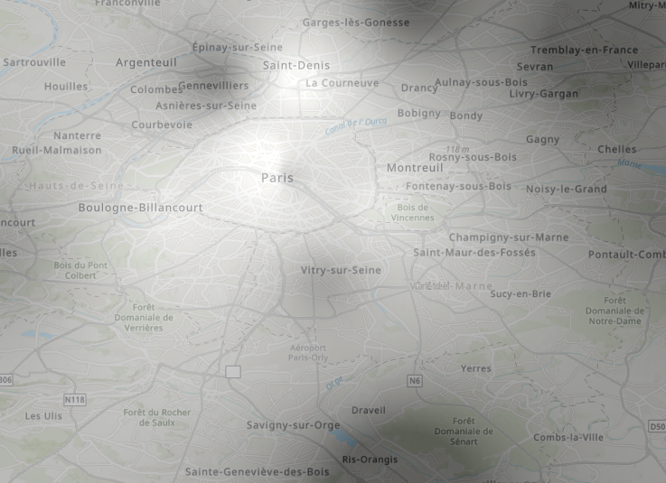
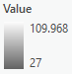
ArcGIS results with visualization
Subraction of the two interpolations to see where the difference is the highest
Notes:
Nicolas

Slide 8
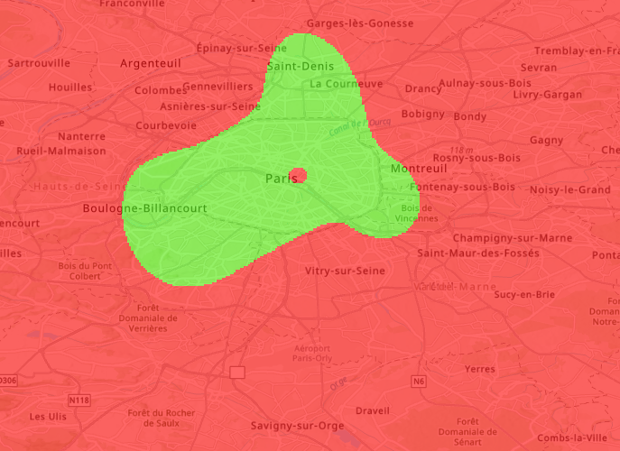

ArcGIS results with visualization
Conversion of the difference into a binary map to see where NO2 level decreased by at least 90 µg/m³
Notes:
Nicolas

Slide 9
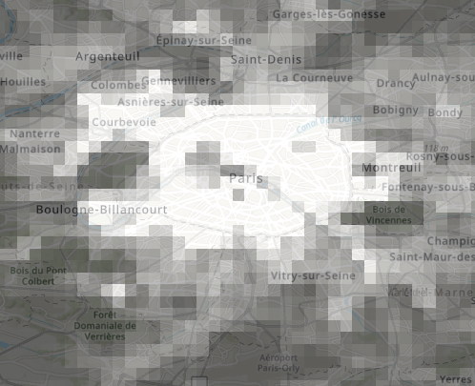
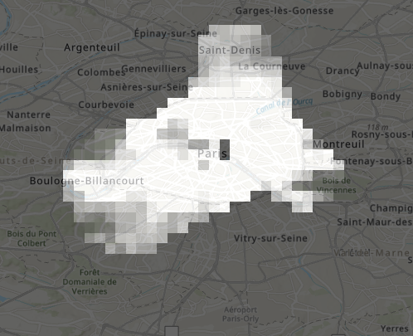
ArcGIS results with visualization
Get the population density where the binary map was 1
Notes:
Nicolas

Slide 10



Why can’t we keep on working only with ArcGIS?
ArcGIS gives great results but it is really slow and fastidious
Advantages of our geo-programming:
Users are able to choose whatever dates they want to do their analysis
Automatically creates files that can be viewed in ArcGIS
Allows to calculate many values over time which is impossible to do manually
Easily updated with more recent dates
Notes:
Alex

Slide 11
Functions created in our Jupyter notebook
test_date (subfunction)
IDW (subfunction)
Difference_IDW (subfunction)
SumPop (subfunction)
varDelta (main function)
varDateDay (main function)
varDateMonth (main function)
Pop_pollu (ArcGIS visualisation function)
Notes:
Nicolas

Slide 12
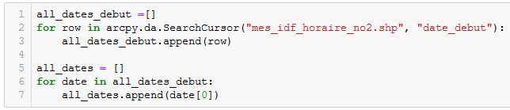
test_date function
Used to check if the date defined by the user is in the database
Notes:
Alex

Slide 13
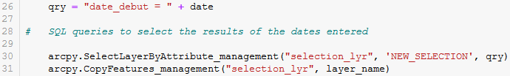
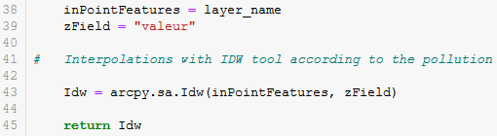
IDW function
Used to calculate the raster interpolation of pollution at a user-defined date :
Notes:
Alex

Slide 14
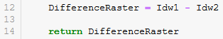
Difference_IDW function
Used to calculate the difference between the raster Idw1 (of the first date) and the raster Idw2 (of the second date):
Notes:
Nicolas

Slide 15
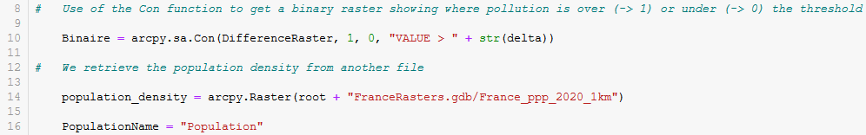
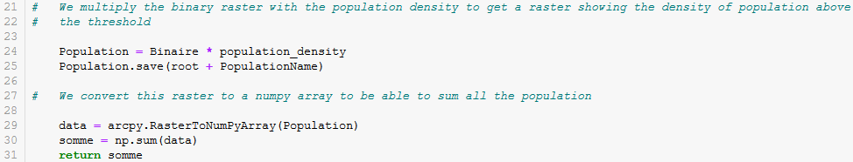
SumPop function
The SumPop function returns the number of inhabitants whose pollution has decreased by a certain user-defined threshold:
Notes:
Nicolas

Slide 16
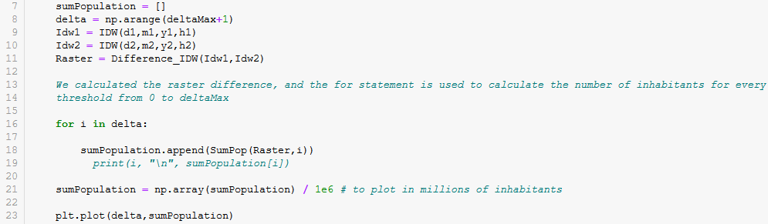
varDelta function
varDelta is a main function that calls the subfunctions to run
Allows interaction with the user
Used to return the graph of the number of inhabitants as a function of the pollution reduction threshold for 2 user-defined dates:
Notes:
Alex

Slide 17
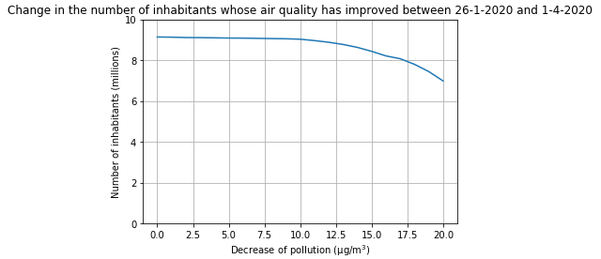
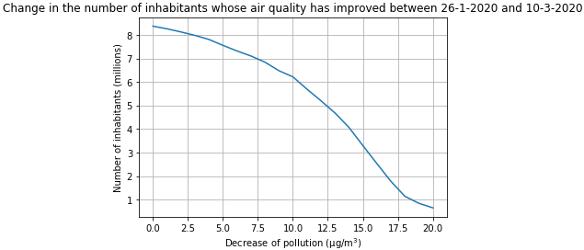
varDelta results
Example of results with the varDelta function :
Notes:
Alex

Slide 18
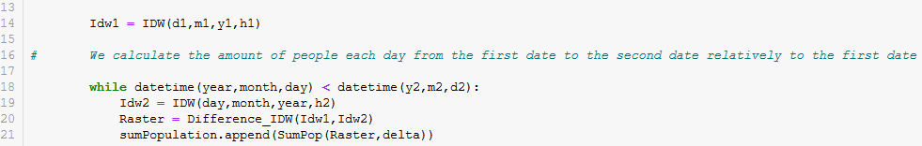
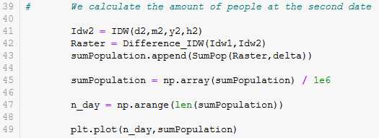
varDateDay function
varDelta is a main function that calls the subfunctions to run
Allows interaction with the user
varDateDay function returns the graph of the number of inhabitants whose pollution has decreased by more than a certain level each day between two user-defined dates:
Notes:
Nicolas

Slide 19
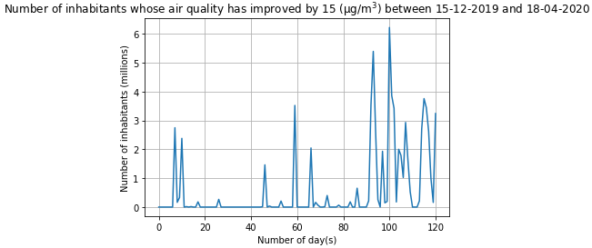
varDateDay results
Example of result of the varDateDay function:
Notes:
Nicolas

Slide 20
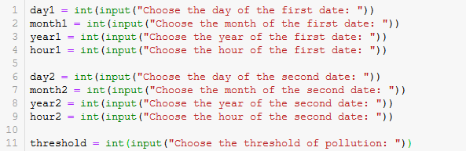
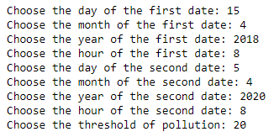
User interface
In order to make the use of these functions more interactive, we used the input function to allow the user to select the dates according to his or her wishes:
Notes:
Nicolas

Slide 21

Conclusion
Our work is conclusive as we saw with several results that the air quality has improved since confinement. Indeed, an increase of the number of inhabitants under a certain threshold of pollution can be seen on our graphs.
Furthermore, our program is easy to use and easy-to-handle and can be updated with recent values.
The future of this work could be to extend the borders of the Paris region to those of France.
Notes:
Alex

